Slide 1
Introducing the MCRLdata Sandbox!
Peter Regier
Notes:
Image: Sequim Bay

Slide 2
Outline
What we have now
What the MCRLdata sandbox adds (and why)
High-level walkthrough
Examples of current capabilities
What’s next
Open forum – what do YOU want?

Slide 3

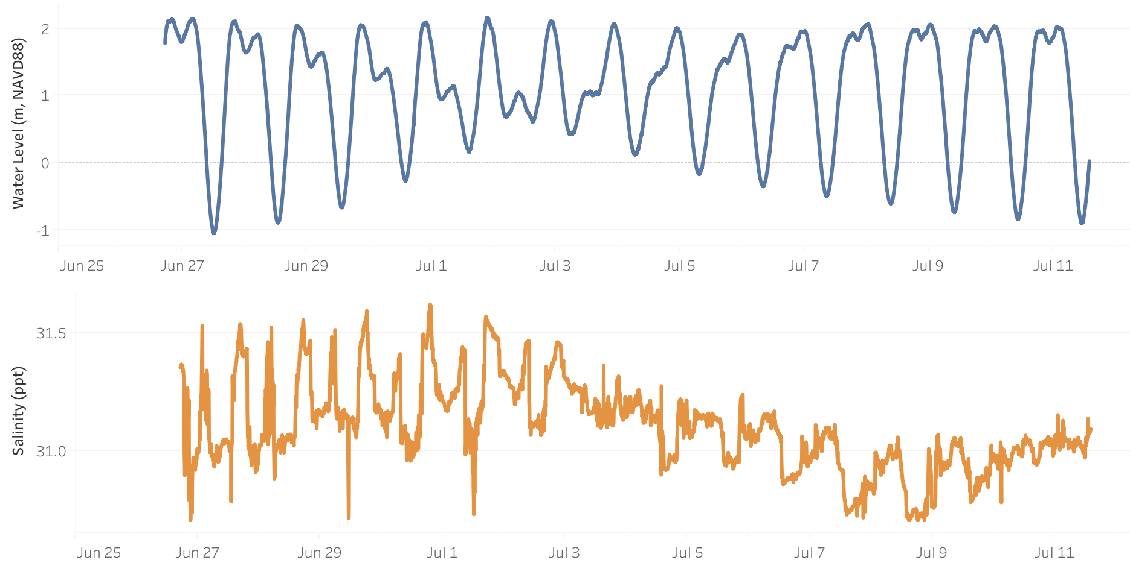
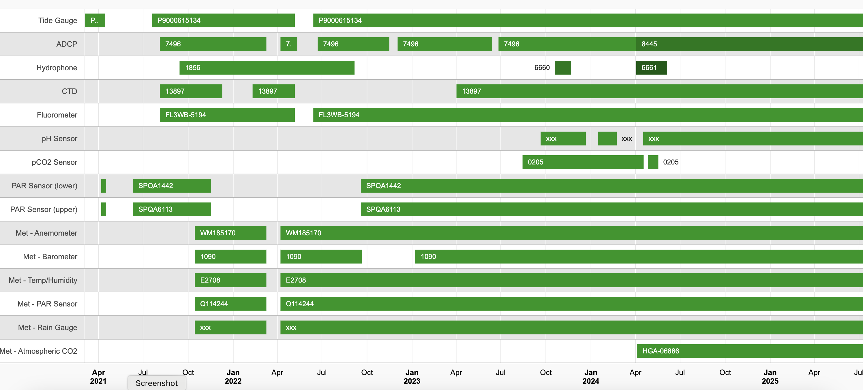
The MCRLdata pipeline
Real-time data plotting
MCRLdata supports “active monitoring and numerical modeling efforts to support coastal research projects, guide operations, and characterize long-term environmental trends in Sequim Bay”
Some key functions
Connects sensors via IOT to the cloud
Hosts datasets and runs some QC
Plots data interactively in real-time
Sensor information
Sensor information
https://mcrldata.pnnl.gov/

Slide 4
Seawater as a Strategic Resource
FY25 SMARTT LDRD funds
Two complementary parts -
Integrated Process Flows
Cross (PI), Myers-Stewart, Boise, Regier, Hemery
Optimizing the MCRL data pipeline (Sandbox and friends)
Regier (PI), Myers-Stewart, Hemery, Boise, Whiting, Cross
Task 1 – Improving data intake
Task 2 – Streamlining data upkeep
Task 3 – Opening data access
Task 4 – Codifying data training

Slide 5

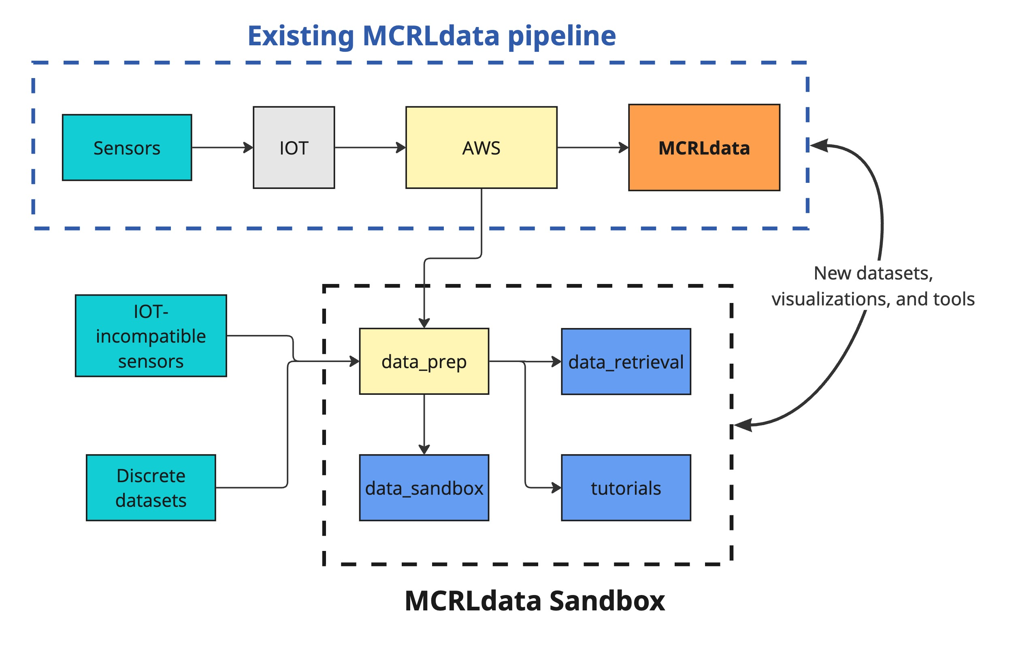
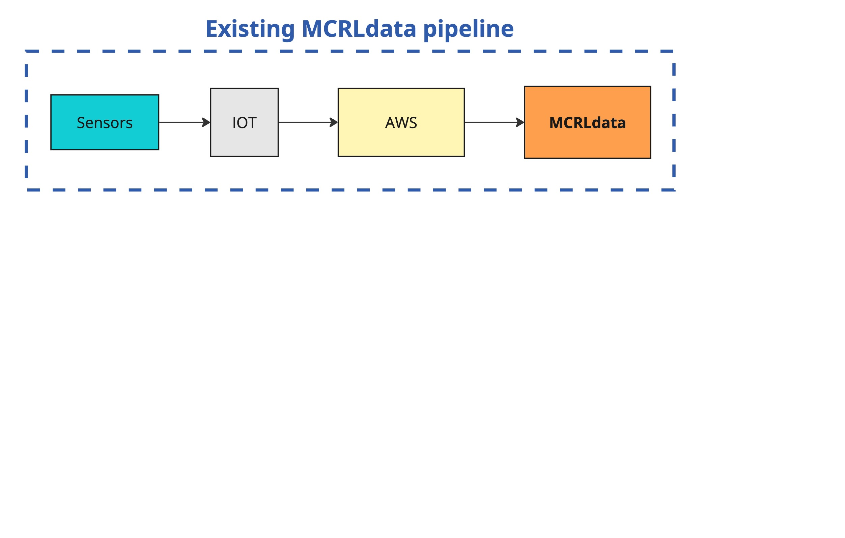
The MCRLdata sandbox
🤝
Enhancing and expanding MCRLdata capabilities
Easier access to data
Additional QC
Additional visualizations
Tutorials to MCRLdata capabilities accessible

Slide 6
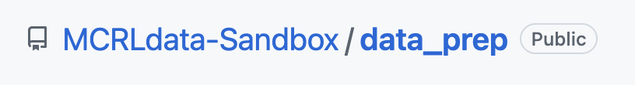
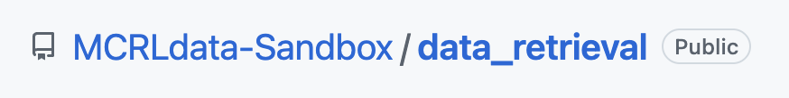
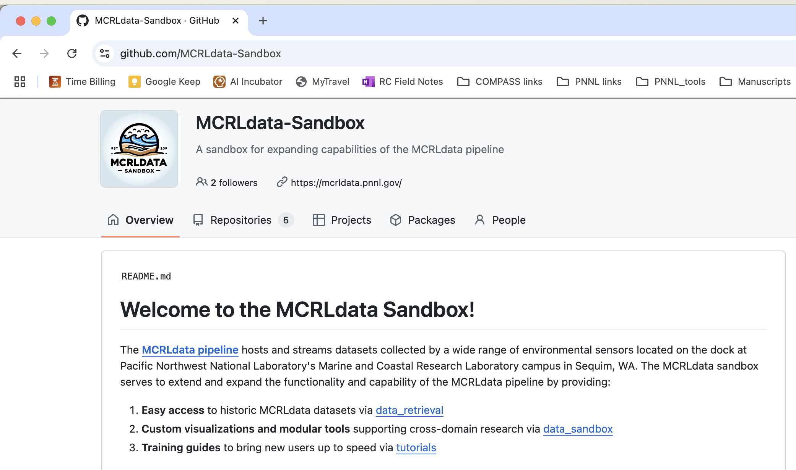
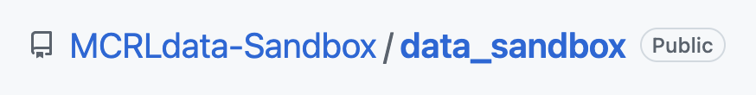
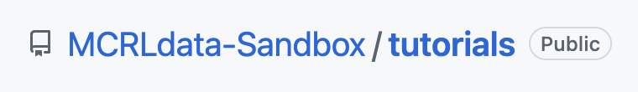
But…. what is it?
🥩
QC datasets, data source for other repos
MCRLdata sandbox = Github organization
An organization contains related repositories
Code is publicly, freely available
Data are publicly, freely available
🛠️
Provides various methods for accessing MCRLdata datasets
⭐️
Provides various methods for accessing MCRLdata datasets
📚
Resources for those new to coding, Github, data, ML, MCRLdata, ….
Play along at home! https://github.com/MCRLdata-Sandbox

Slide 7

Overview – current contents
🥩
⭐️
L1-cleaned datasets (remove flags, potential additional QC) – analysis-ready*
Tide gauge water levels
ADCP velocities
Met station Air temps/windspeeds
CTD water temps/salinity
TA/DIC (Cross LDRD)
Many plots
Seasonal ops-focused summary
Natural variability envelopes
📚
🛠️
Available tutorials
Setting up R/Rstudio
Intro to coding in R
Intro to ML (Random Forests)
Provides various methods for accessing MCRLdata datasets
* Only YOU know what data quality your project/application needs!

Slide 8
Examples – enhanced QC for select datasets

Slide 9
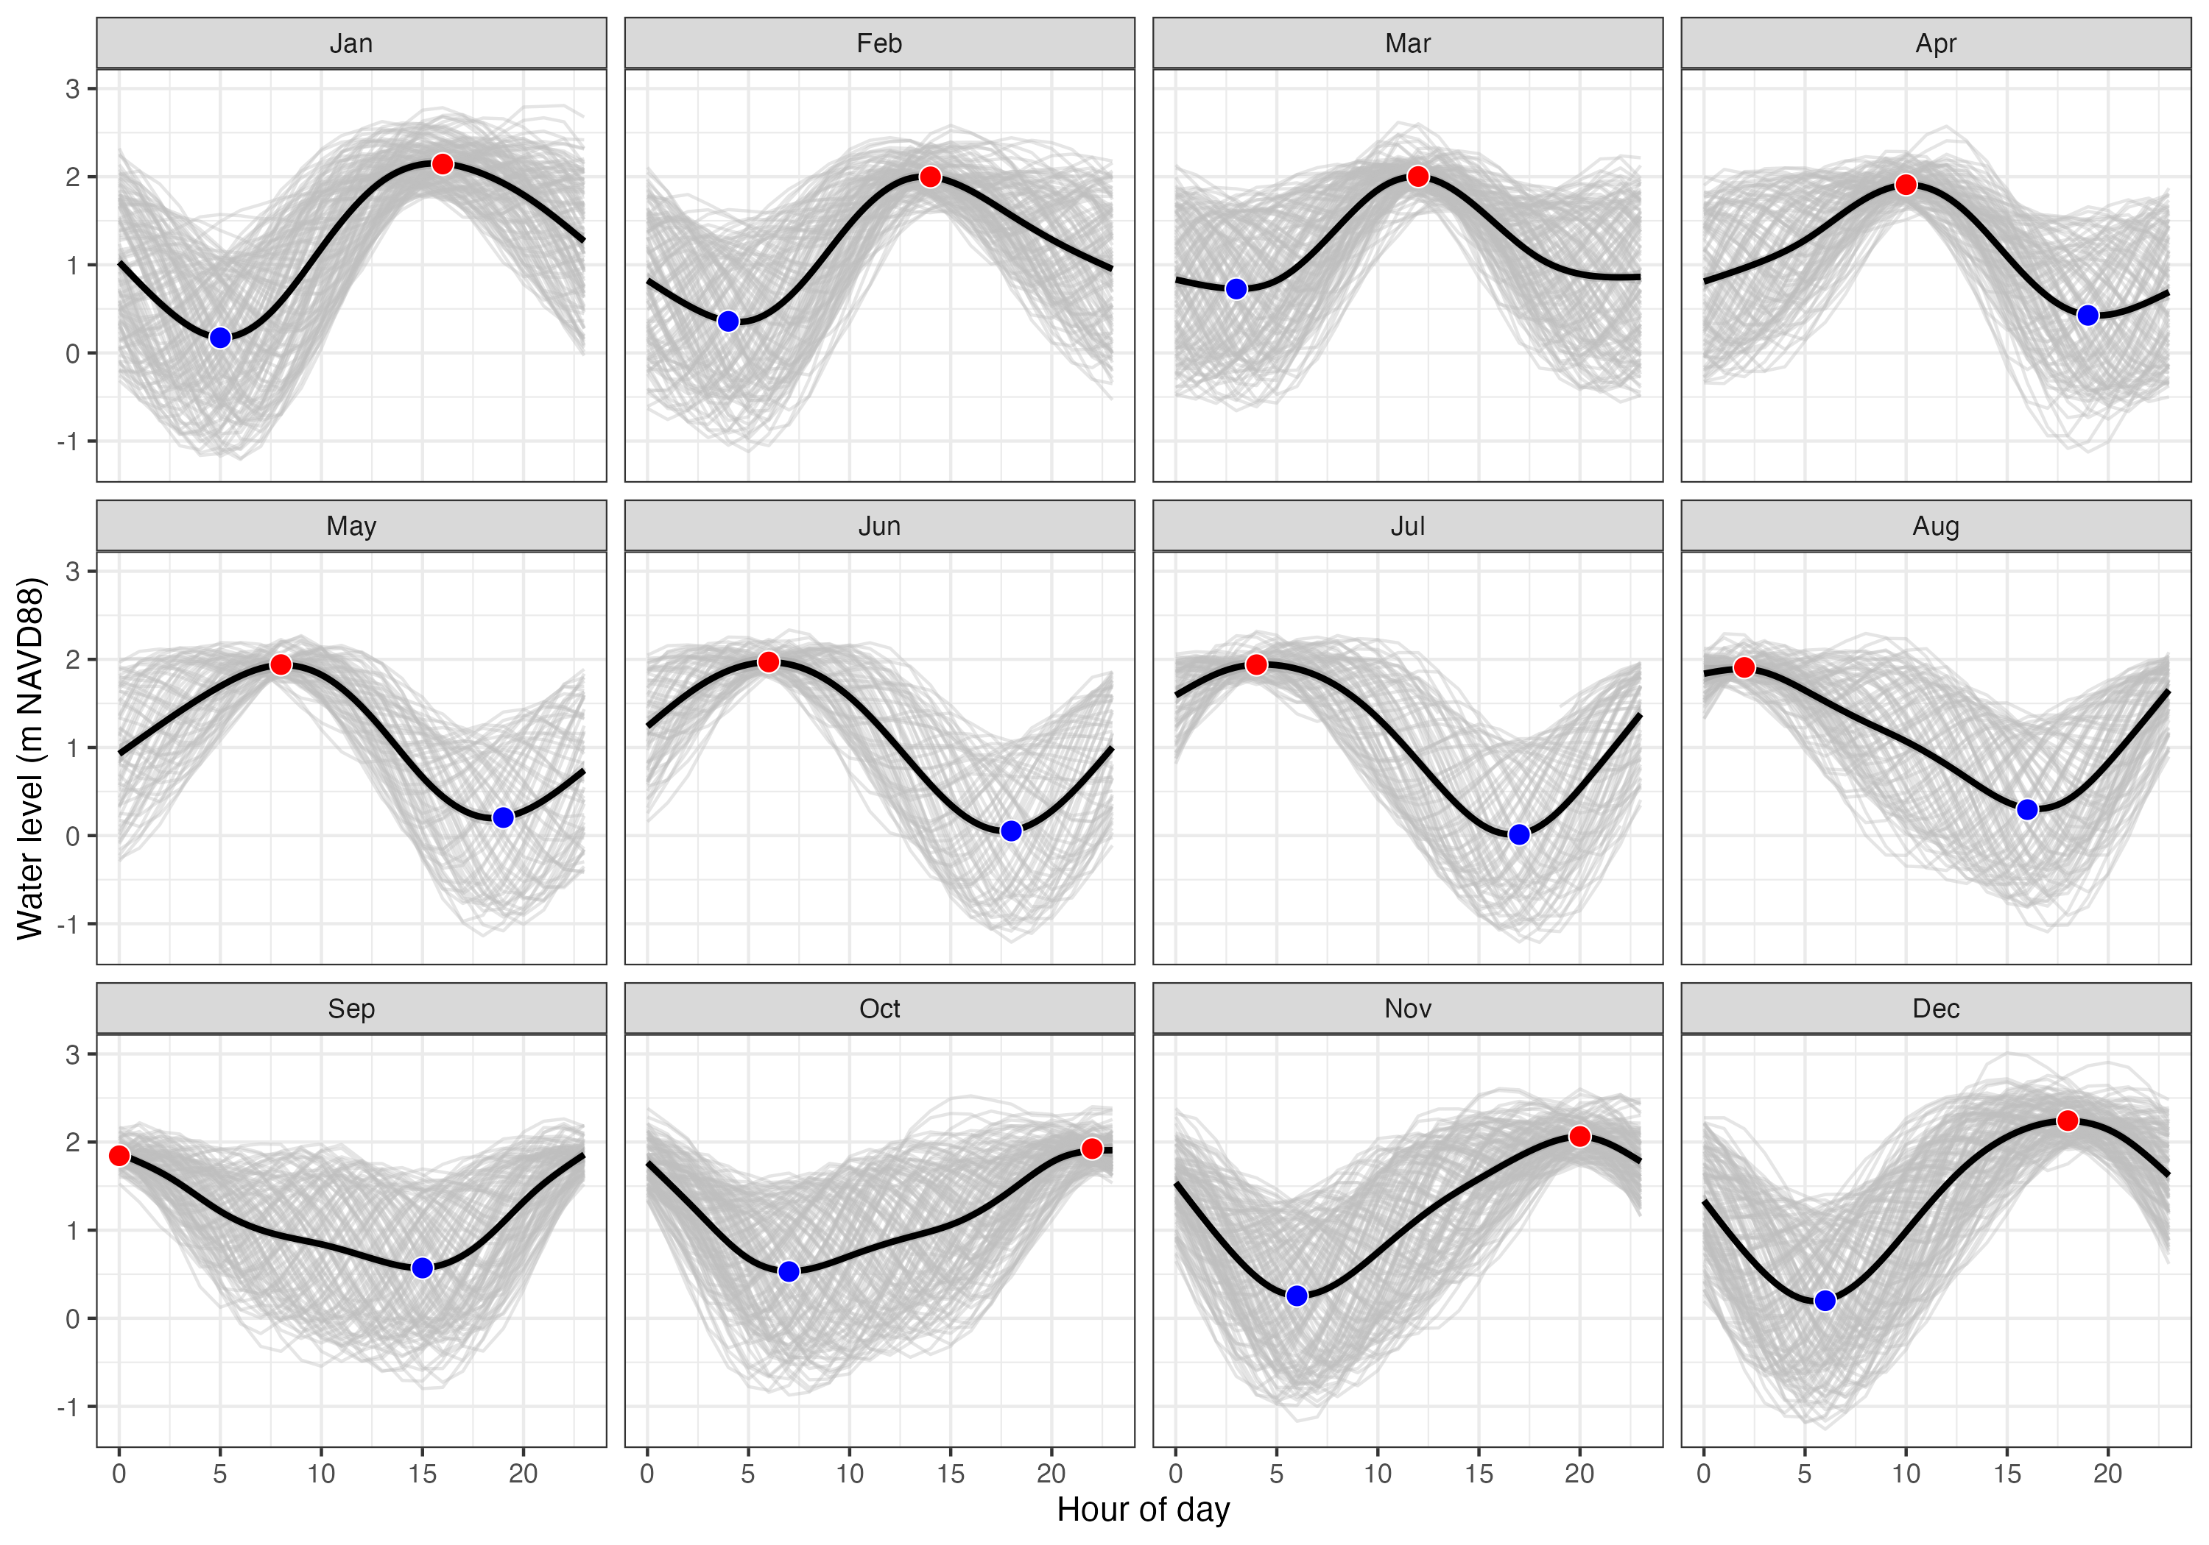
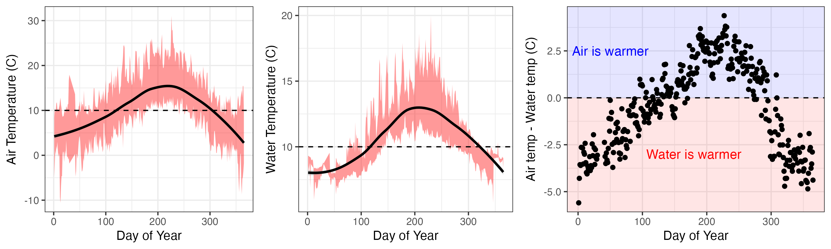
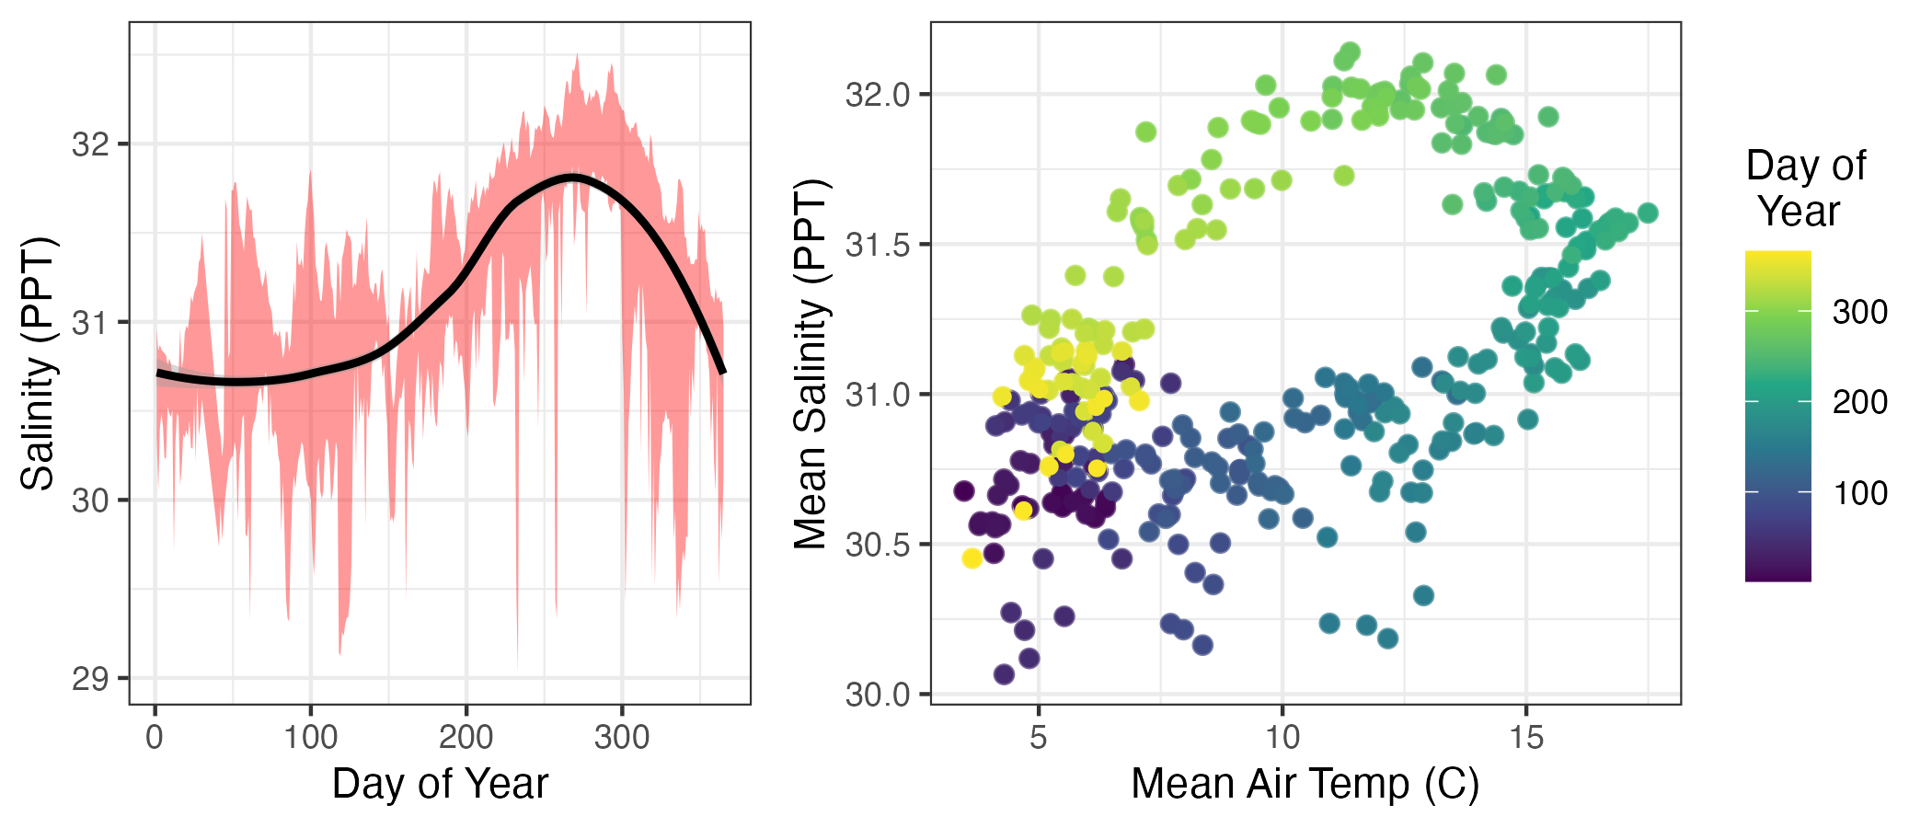
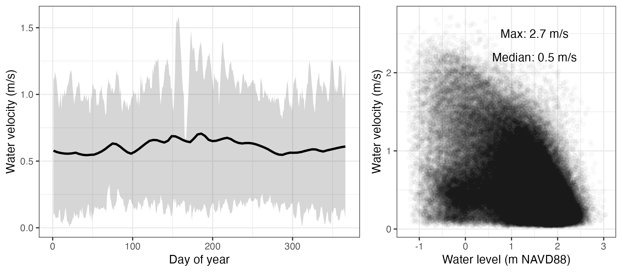
Example – Context for Sequim Bay ops
Air and water temperatures
Tidal water levels
Salinity patterns and relationships
Water velocities
https://github.com/MCRLdata-Sandbox/data_sandbox/blob/main/scripts/3_sequim_bay_seasonality.md

Slide 10
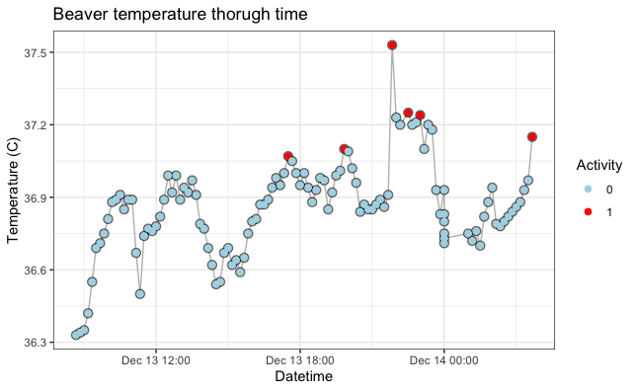
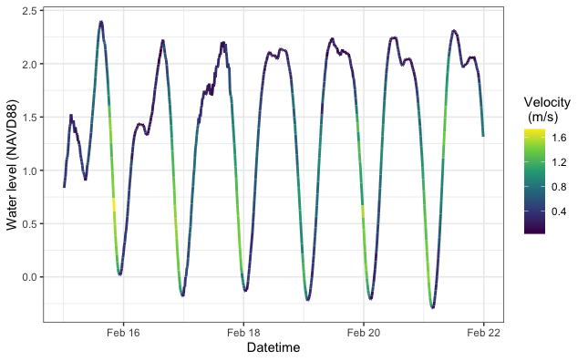
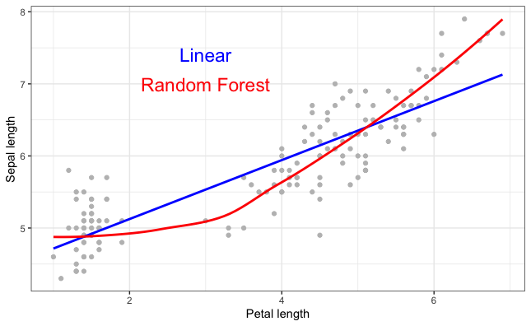
Examples – Tutorials (focused on R… for now)
R basics
Installing packages
Working with data
Making plots
L1 data basics
Pulling data from sandbox
Working with it
Making plots
Machine learning basics
The whats and whys
Prepping a model
Interpreting output

Slide 11
What’s next?
Planned for FY25
Improve tutorials on Github use
Track read-from-raw Github-mediated interactions
Design a logo without nonsense
High-priority community feedback!
Wishlist
Expand R tutorials to Python

Slide 12
The most important part
How can the sandbox help you?
What plots/stats would help your work?
Which parameters do you care about most?
What other content/capabilities do you want?
Feedback

